Slide 1

Implementation and Fault-tolerance Tests of High Availability System in Cloud Environment
Sonjongyoung_2012105055
Kimsunhee_2016115113
Baekeunryeong_2016114418
Chohyunkyung_2016117078

Slide 2
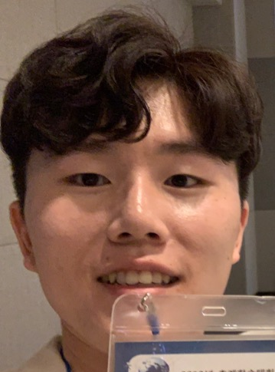
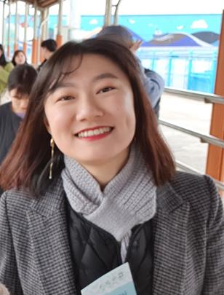


Team Members
Construct WEB/WAS server
System Integration
Construct testing environment
System testing
Construct WEB/WAS server
Manage Trello
Construct testing environment
Manage Git
JongYoung Son
KeunRyeong Bae
HyunKyung Cho
SunHee Kim

Slide 3
CONTENTS
Ⅰ. Background
- Existing Architecture of Current Web System
- Construct High-Availability Web System
Ⅱ. Project Progress
- Implementation
- Test for High-Availability
Ⅲ. Activities
- Working History
- Achivement

Slide 4




Ⅰ. Background
Existing Construction of WEB/WAS
Cloud
WAS 1
Web Browser
WEB
WAS n
Clustering many servers to cope with traffic more

Slide 5





Ⅰ. Background
Importance of High-Availability Web System
Performance
Reliability
Scalability
Manageability
.
.
WEB/WAS Architecture
- Public Cloud Environment (AWS, GCP, etc…)
- Open Source Middleware
- Optimization for each service
Most Popular middleware (Community)

Slide 6




Ⅰ. Background
Existing Construction of WEB/WAS
The Black Friday crush
the server every year.
『WAS1』
Web Browser
『WEB』
『WAS2』

Slide 7
Load
Balancing
High
Availability
Sticky
Session
PURCHARE
Session
Clustering

Slide 8
Ⅱ. Project Progress
Clustering Servers
Without
Load Balancing
WAS 1
WEB
WAS n

Slide 9

Ⅱ. Project Progress
Clustering Servers
Without
Sticky Session
Cloud
A
A
WAS 1
B
WEB
WAS 2
Web Browser

Slide 10


Ⅱ. Project Progress
Clustering Servers
Session Clustering
Cloud
WAS 1
Web Browser
WEB
WAS 2

Slide 11
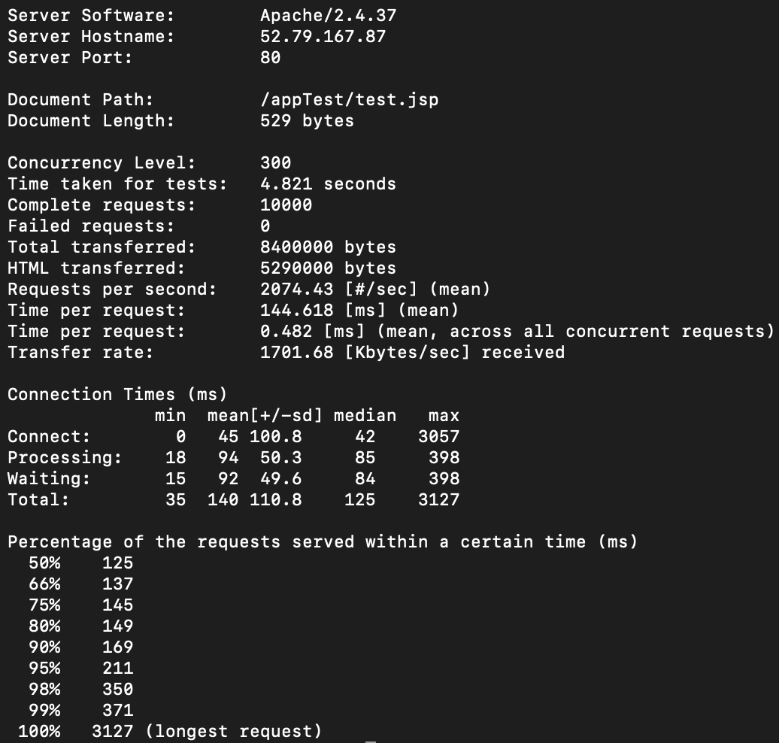
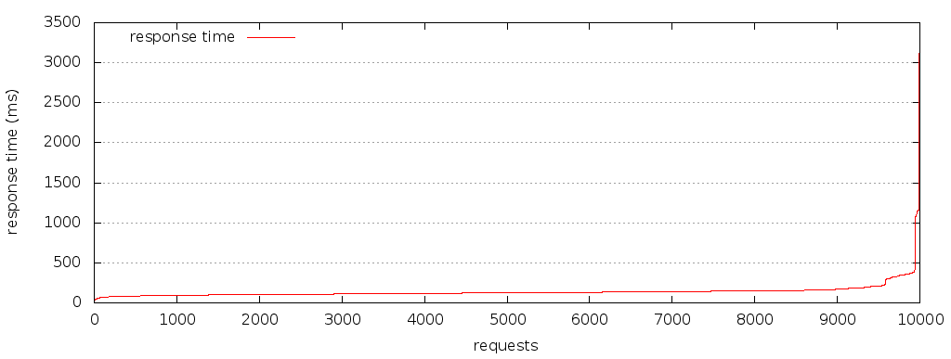
Ⅱ. Project Progress
Fault-tolerance Test

Slide 12
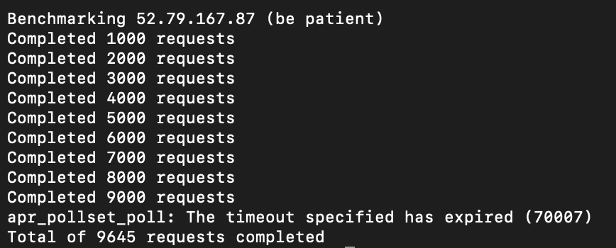
Ⅱ. Project Progress
Fault-tolerance Test

Slide 13
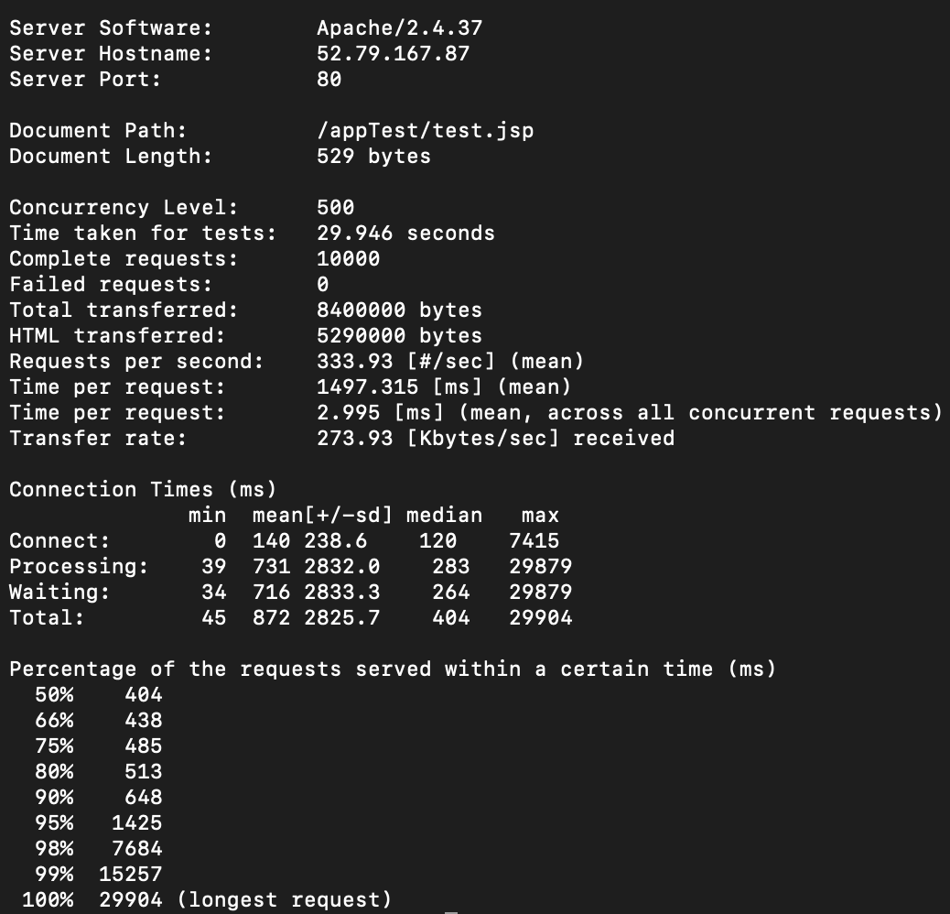
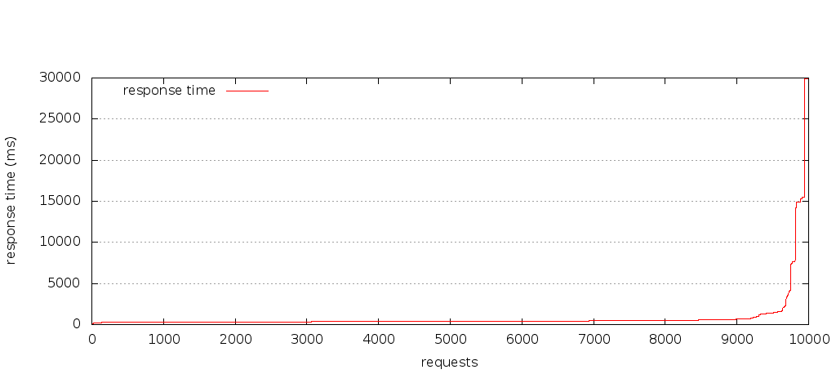
Ⅱ. Project Progress
Fault-tolerance Test

Slide 14


Ⅱ. Project Progress
Fault-tolerance Test

Slide 15
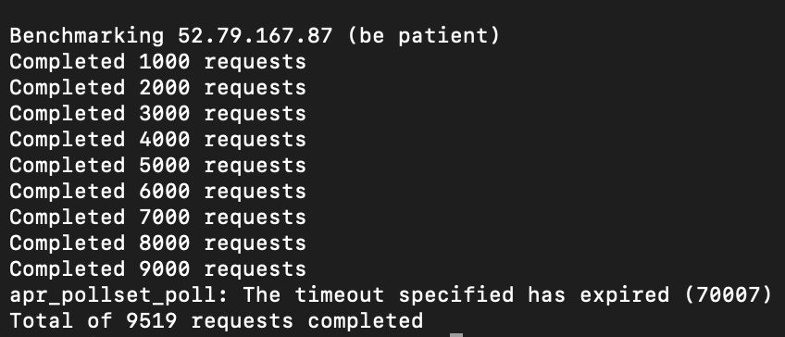
Ⅱ. Project Progress
Fault-tolerance Test

Slide 16
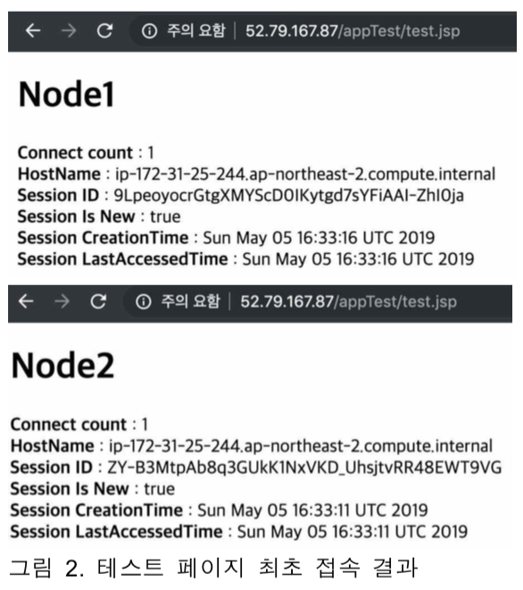
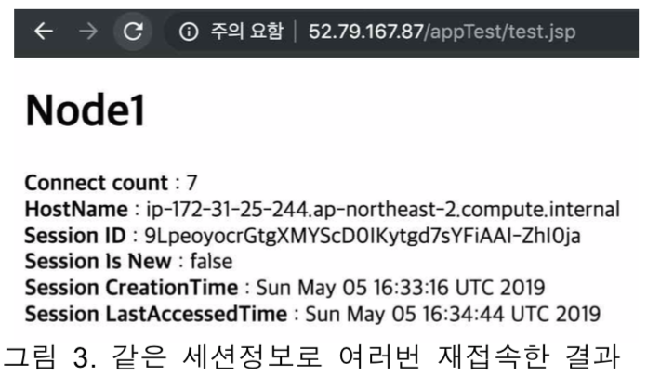
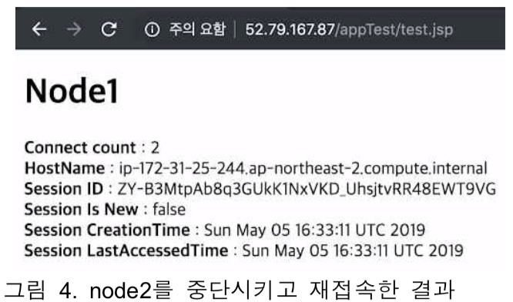
Ⅱ. Project Progress
Fault-tolerance Test
그림 3. 같은 세션정보로 여러 번 재접속한 결과
그림 2. 테스트 페이지 최초 접속 결과
그림 4. node2를 중단시키고 재접속한 결과

Slide 17
Demonstration
https://youtu.be/80q_KeZG-xU

Slide 18
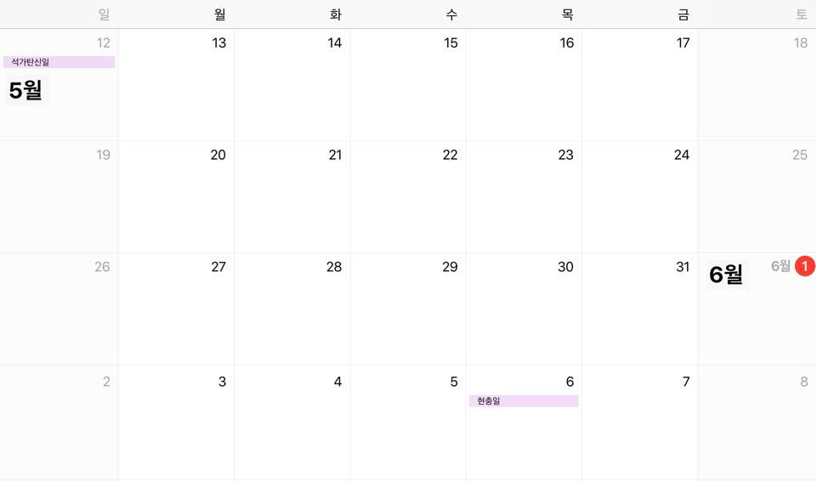
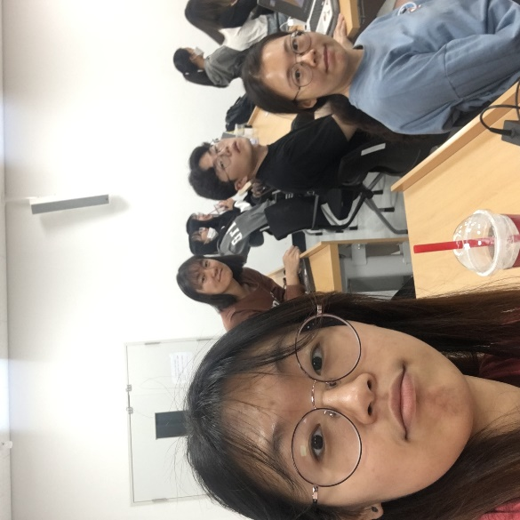
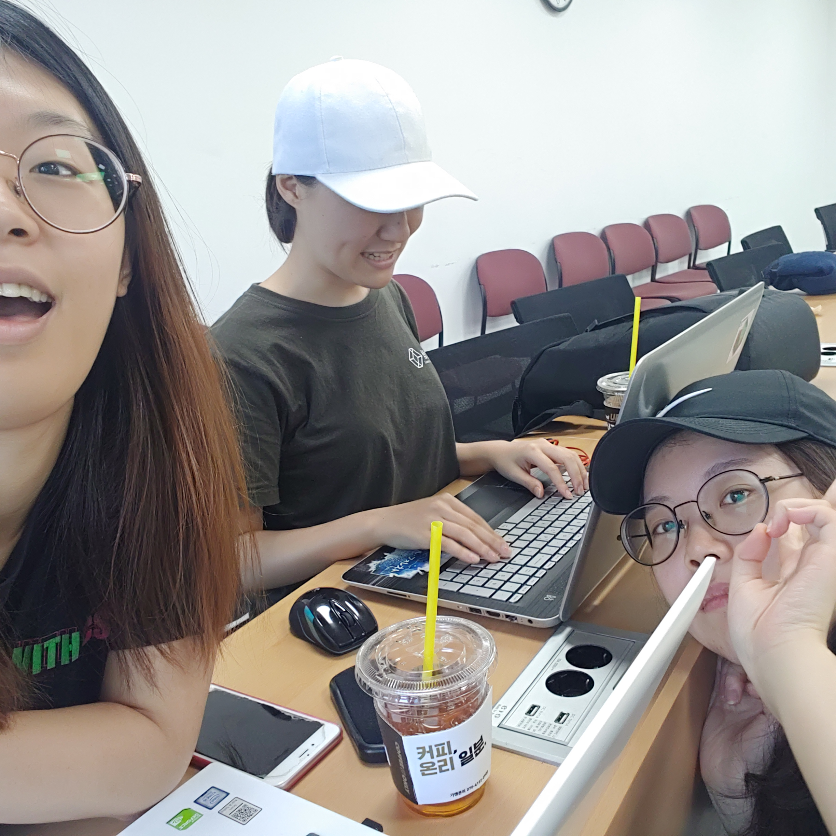
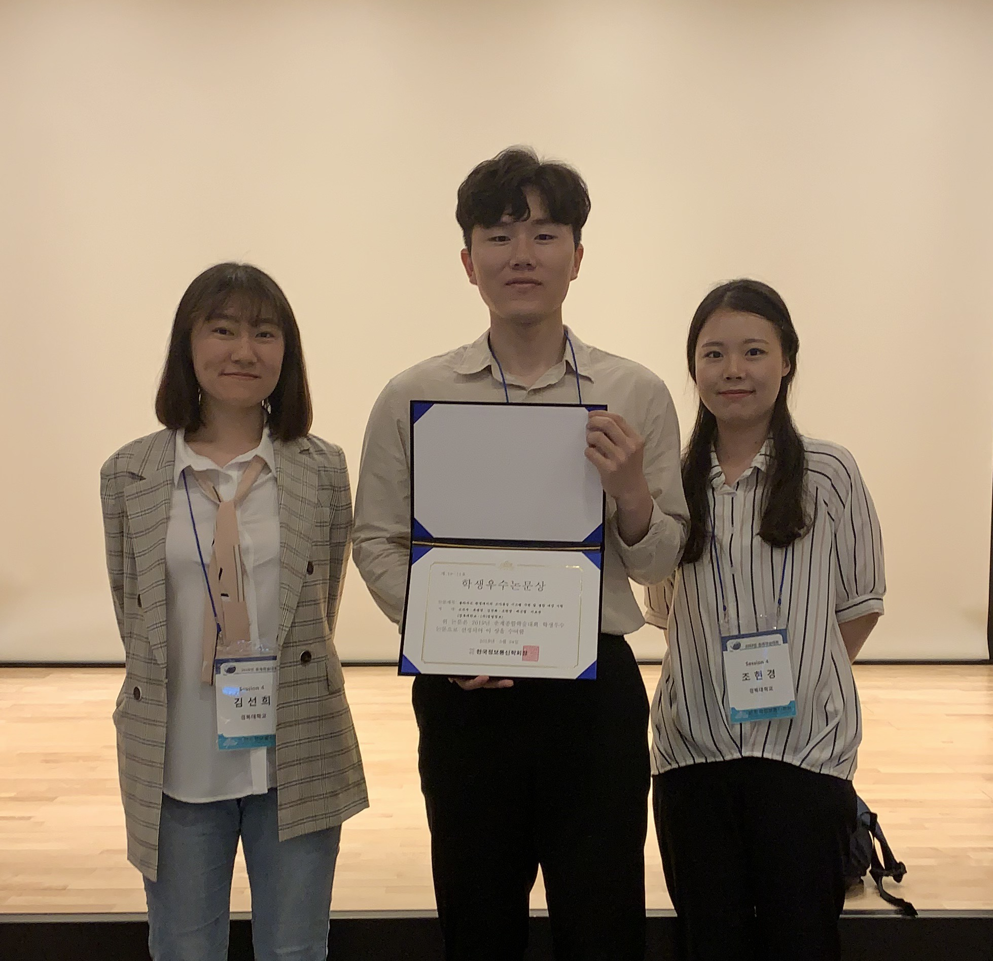
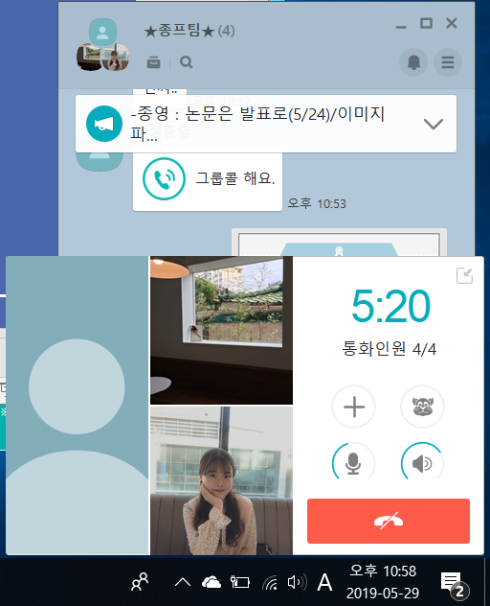
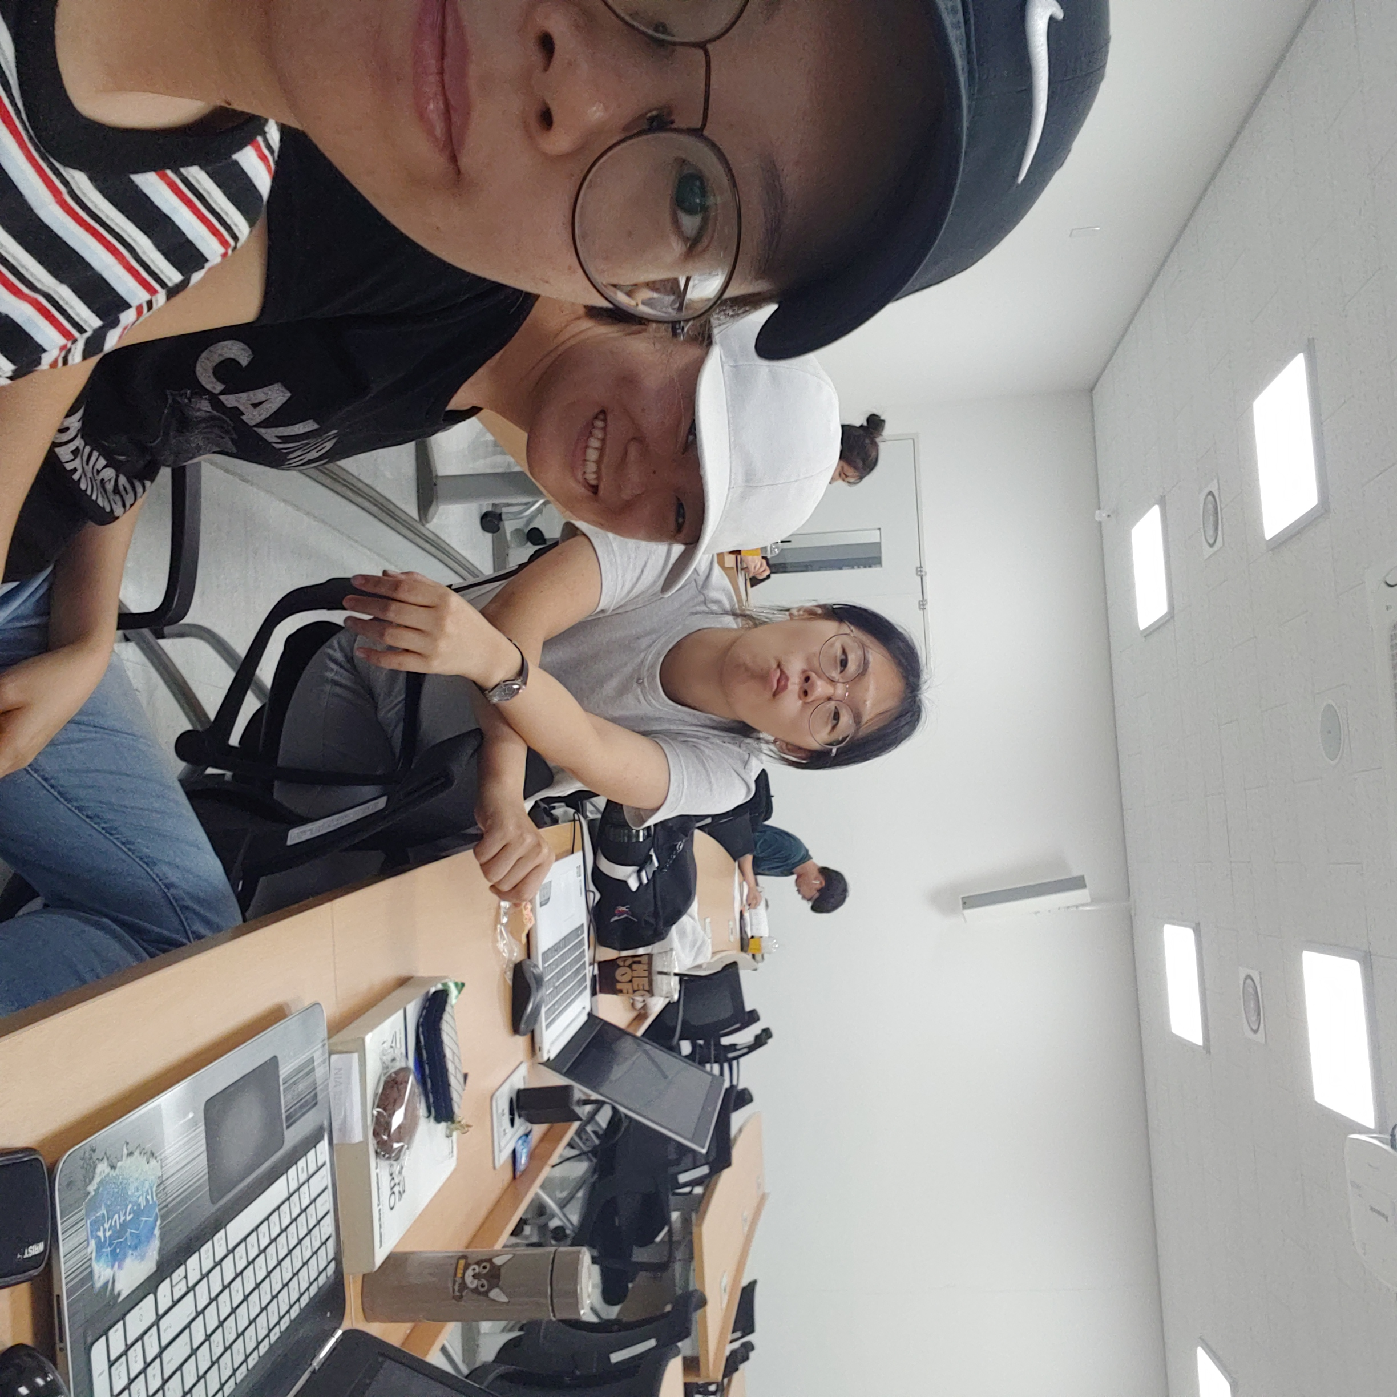
Ⅲ. Activities
Offline & Online
Today

Slide 19
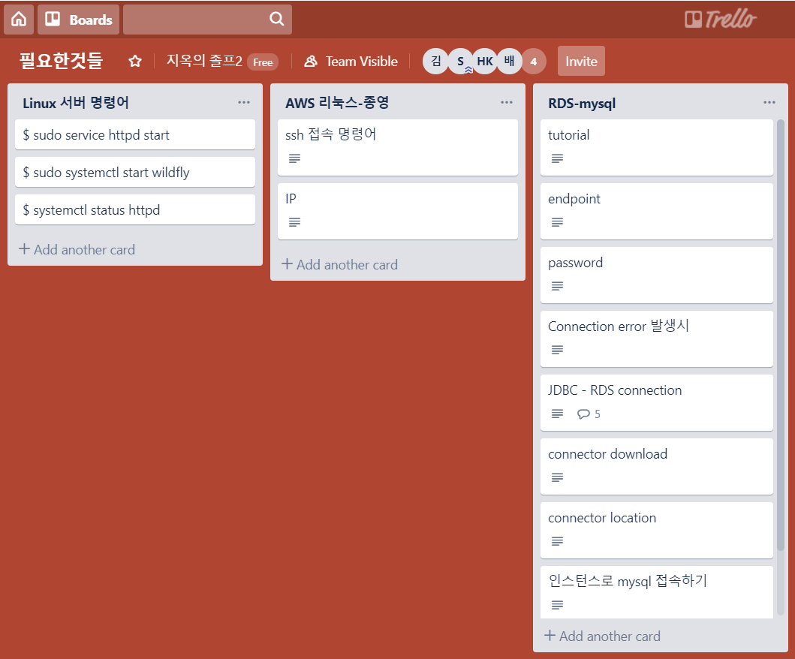
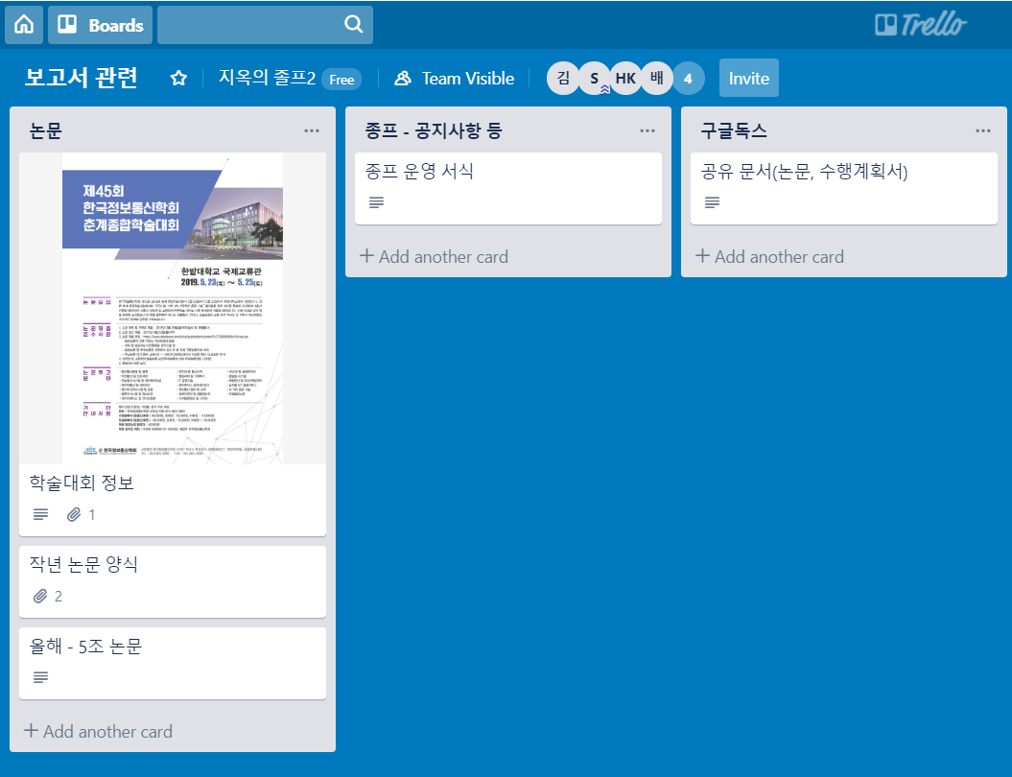
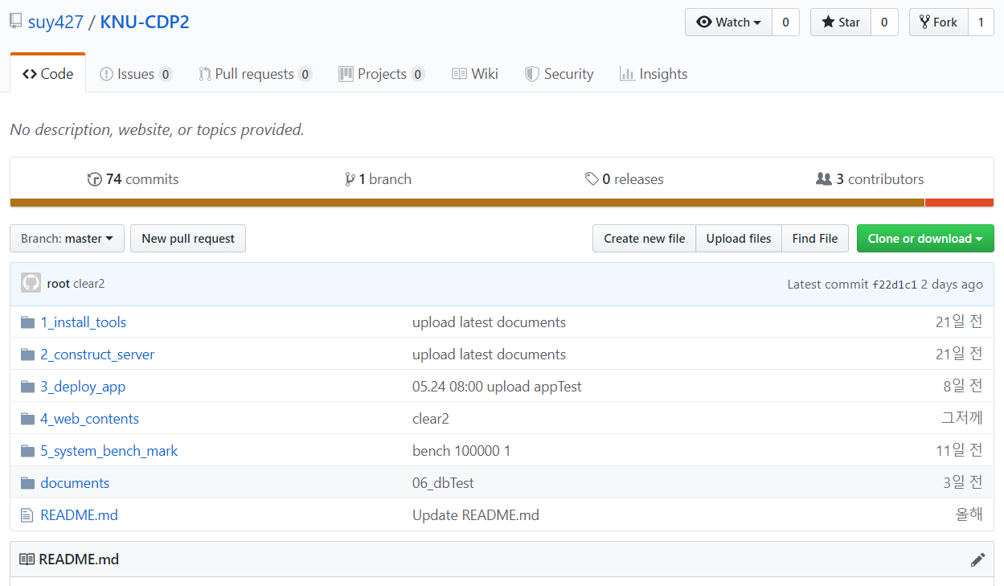
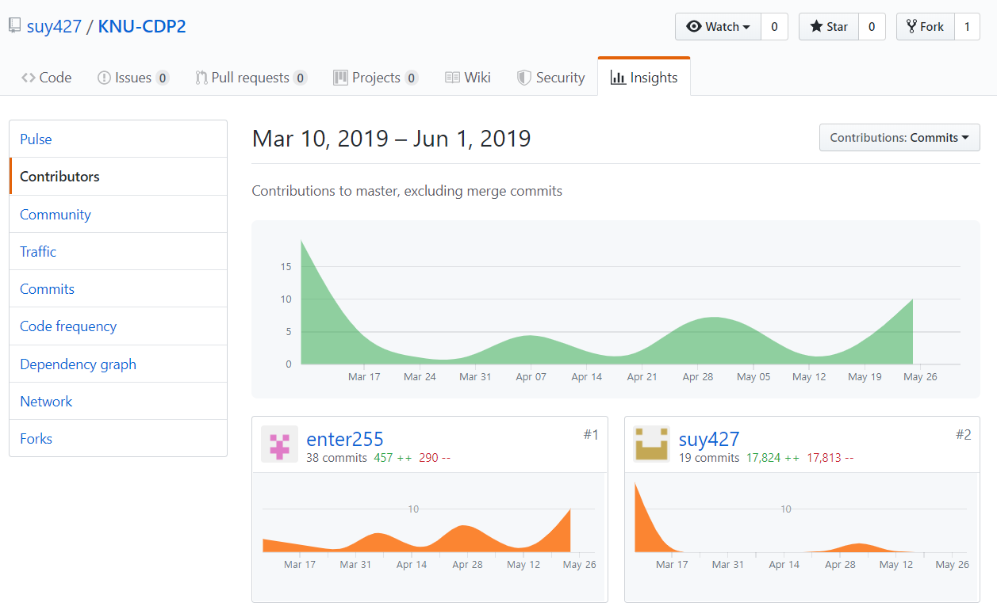
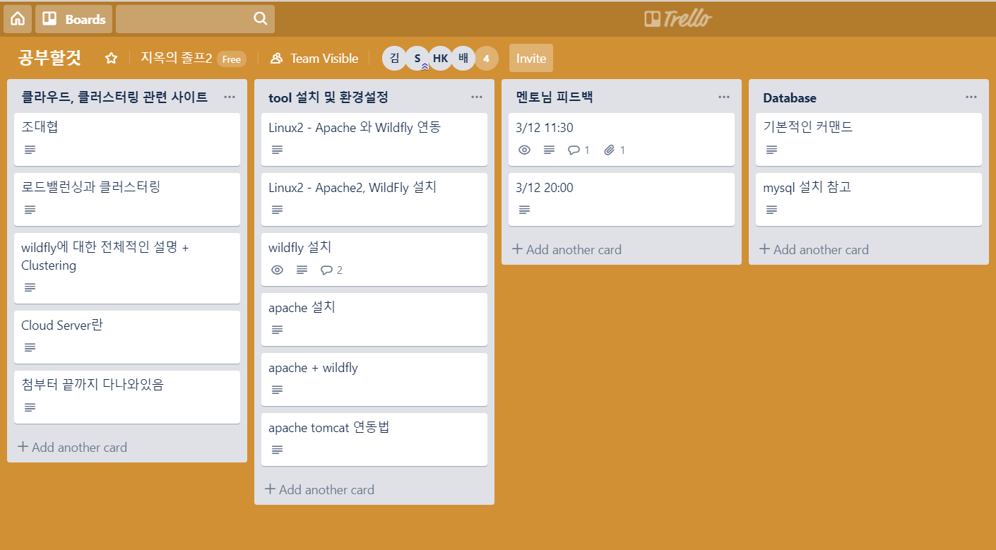
Ⅲ. Activities
Trello
Github
Materials and Schedule Management
Project Documents and Sources Management

Slide 20
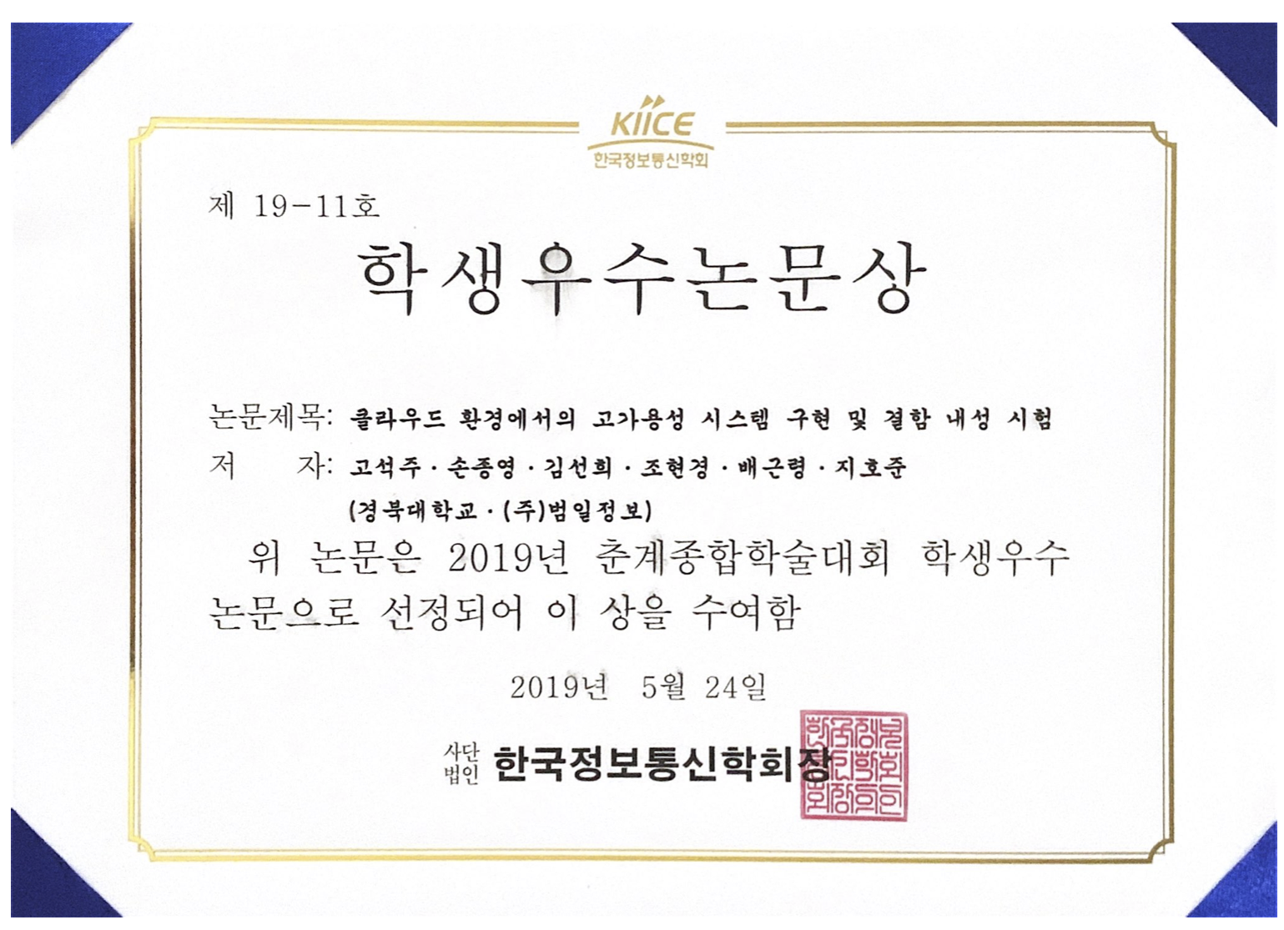
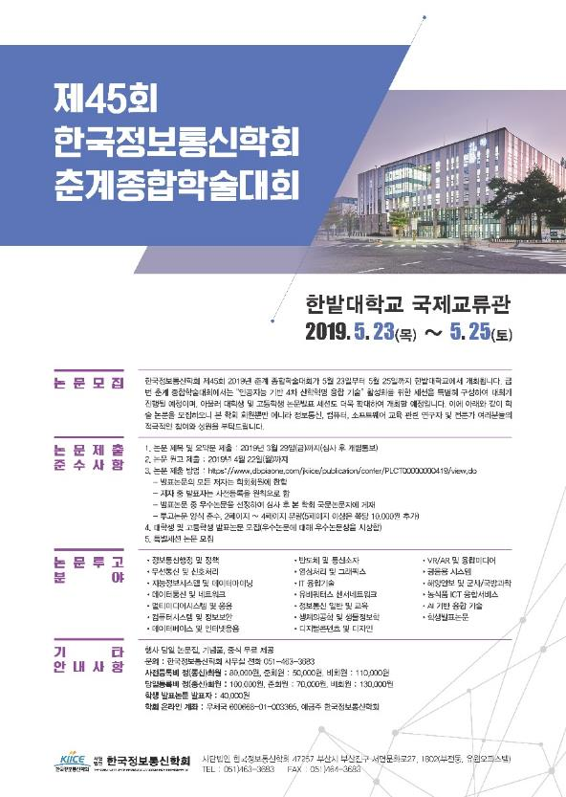
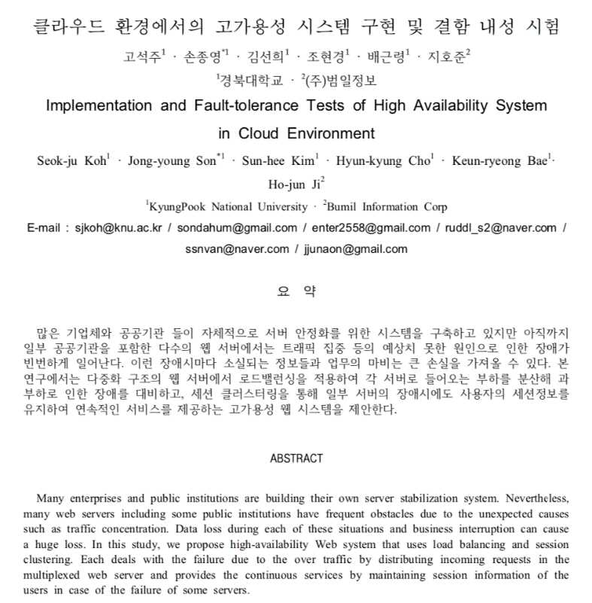
Ⅲ. Activities
Paper

Slide 21
Thank you

